Slide 1
FACIAL EXPRESSION & EMOTION RECOGNITION FOR SOCIAL INTERACTION
Empowering Visually Impaired Individuals through AI
GROUP ID – NFT202536
VRAJ BORAD – BT23CSE119
DEEV SHAH – BT23CSE108

Slide 2
TABLE OF CONTENTS
01
02
03
04
05
06
THE UNSEEN CHALLANGE
07
USER INTERFACE DESIGN
PROPOSED SOLUTION
08
NEURO-FUZZY INTEGRATION
TECH-STACK
09
CHALLENGES & SOLUTIONS
ARCHITECTURE & WORKFLOW
10
FUTURE EHNANCEMENTS
11
MODEL TRAINING & PERFORMANCE
CONCLUSION & IMPACT
PROGRESS & ANALYSIS

Slide 3
THE UNSEEN CHALLENGE
SOCIAL BARRIERS FOR VISUALLY IMPAIRED
BARRIER | Blind individuals cannot perceive facial expressions during conversations
BARRIER | This creates significant social communication barriers
BARRIER | Missing emotional cues leads to misunderstanding and isolation
IMPACT | Difficulty in understanding social contexts
IMPACT | Challenges in professional and personal interactions
IMPACT | Limited access to non verbal communication

Slide 4
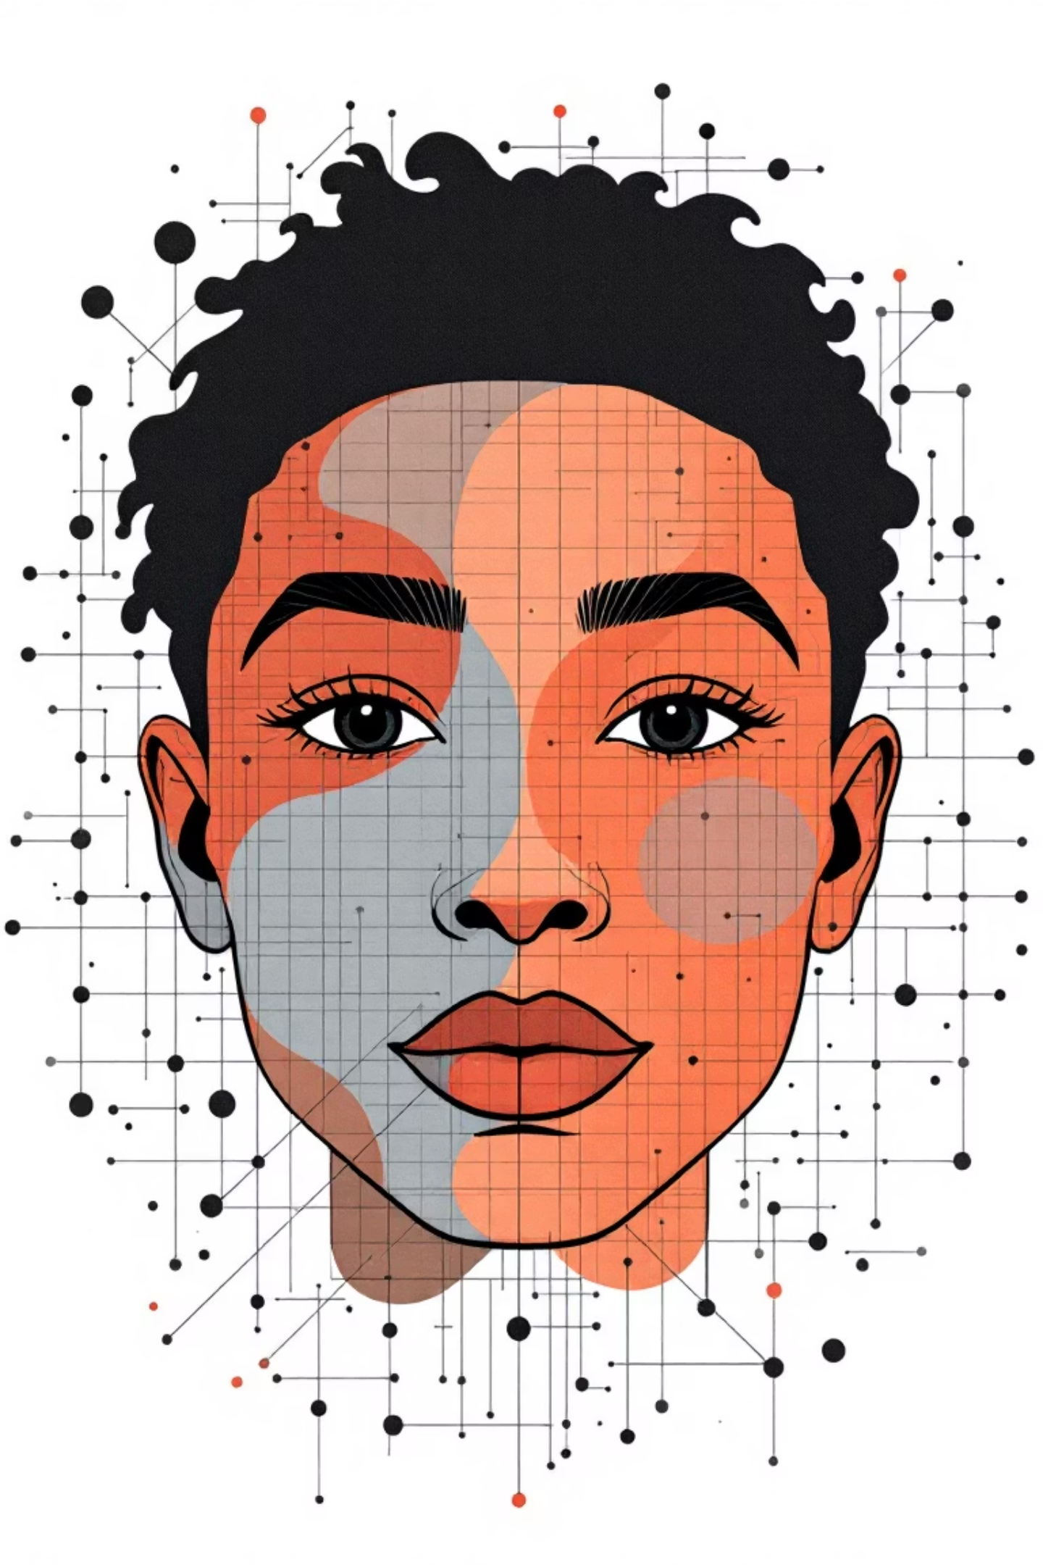
PROPOSED SOLUTION
Core Concept:
Real-time facial emotion detection using deep learning
Instant audio feedback for blind users
Neuro-fuzzy logic for nuanced emotional interpretation
Key Features:
Live camera input processing
7-emotion classification (Happy, Sad, Angry, Fear, Surprise, Disgust, Neutral)
Text-to-speech audio cues
Continuous real-time operation

Slide 5
TECH-STACK
BACKEND CORE
FRONTEND CORE
Python with PyTorch framework
MTCNN for face detection
Custom CNN for emotion classification
Sci-kit fuzzy for fuzzy logic
OpenCV for video processing
Tkinter for user interface
gTTs for text-to-speech
Standard webcam input

Slide 6
ARCHITECTURE & WORKFLOW
Video Capture - 30fps real-time feed
Face Detection - MTCNN with green bounding boxes
Feature Extraction - CNN processes facial features
Neuro-Fuzzy Decision - Refines emotion probabilities
Audio Output - Text-to-speech conversion
Continuous loop – 3-second update cycle

Slide 7
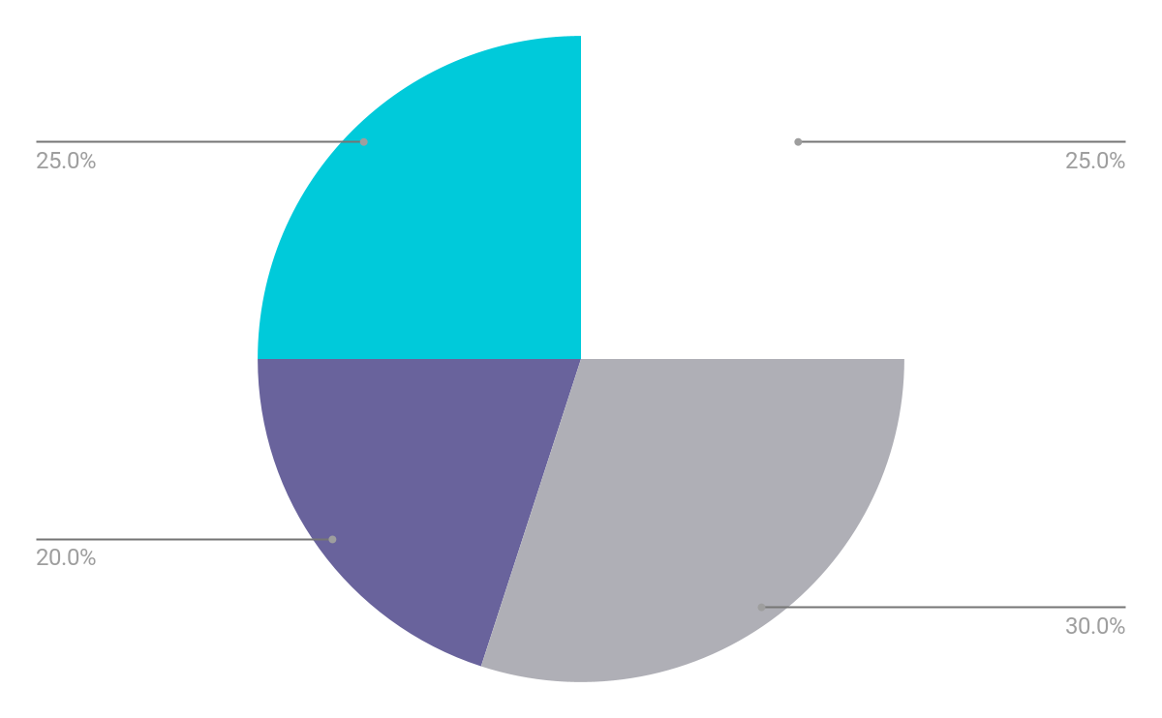
MODEL TRAINING & PERFORMANCE
TRAINING DETAILS
PERFORMANCE METRICS
Dataset: FER2013 - Facial Expression Recognition
Model: Custom CNN Architecture
Epochs: 35 completed training cycles
Training Time: ~590 seconds per epoch
Training Accuracy: 92.72% (Epoch 35)
Training Loss: 0.2067 (Epoch 35)
Validation Accuracy: 60.46% (Epoch 35)
Consistent improvement over training period

Slide 8
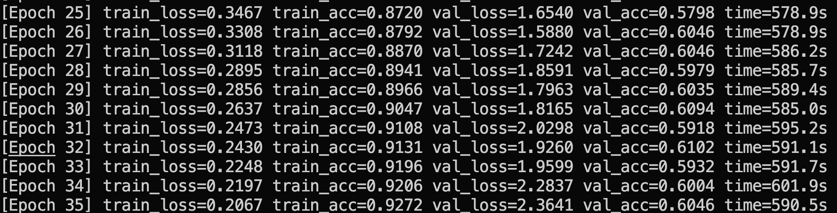
PROGRESS & ANALYSIS
Key Observations:
Steady Improvement: Training accuracy increased from ~87% to ~93%
Loss Reduction: Training loss decreased from 0.34 to 0.20
Validation Stability: Consistent ~60% validation accuracy
No Overfitting: Controlled gap between training and validation

Slide 9
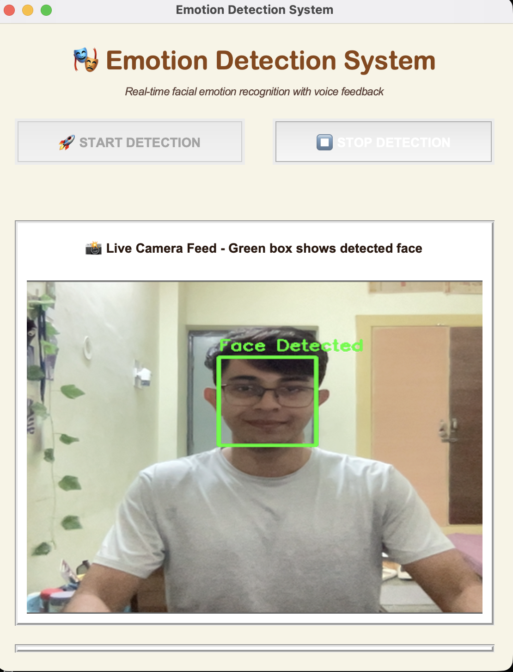
USER INTERFACE DESIGN
VISUALS
Heading
Start and Stop buttons
IN UI WEBCAM
DETECTION
Integrated webcam feature inside the UI
Detects the face and creates a box around it
CAPTURING
Real-time face capturing and detection

Slide 10
NEURO-FUZZY INTEGRATION
Neuro-Fuzzy Layer:
Purpose: Handle emotional ambiguity and blends
Input: CNN probability distributions
Processing: Fuzzy rules for nuanced decisions
Output: Refined, confident emotion labels
Example Scenario:
CNN Output: Happy (65%), Neutral (20%), Sad (10%)
Fuzzy Logic: "If Happy > medium AND Neutral < low THEN confirm Happy"
Final Decision: "Happy" with high confidence

Slide 11
CHALLENGES & SOLUTIONS
MAJOR CHALLANGES
OUR SOLUTIONS
Tensor Dimension Mismatch - MTCNN [3,160,160] vs CNN [3,48,48]
Real-time Performance - Balancing accuracy and speed
Lighting Variations - Consistent detection in different conditions
Audio Feedback Optimization - Preventing speech fatigue
Custom Preprocessing Pipeline with proper tensor resizing
3-Second Update Interval for optimal performance
MTCNN Robustness with confidence thresholding
Intelligent TTS with emotion confirmation logic

Slide 12
FUTURE EHNANCEMENTS
LONG TERM VISION
SOCIAL IMPACT
SHORT TERM IMPROVEMENTS
Wearable glasses integration
Multi-modal sensing (voice + facial)
Cloud-based model updates
Multi-language support
Commercial product development
Accessibility tool for organizations
Open-source community contribution
Multi-face detection and analysis
Emotion intensity levels
Mobile application development
Enhanced model accuracy

Slide 13

CONCLUSION & IMPACT
Key Achievements:
✅ Working real-time emotion detection system
✅ High-accuracy face detection with MTCNN
✅ Neuro-fuzzy enhanced decision making
Social Impact:
Breaking communication barriers for visually impaired
Enhancing social confidence and independence
Hackathon Reports: https://drive.google.com/drive/folders/1UOLe7r-7qgJ6dbr3QA9gsJB7MP4BbhZB?usp=sharing
https://drive.google.com/drive/folders/1C-FfSPfTmcTyVFrd_8OwyMAdWF0dVlsl

